Slide 1
Introduction to R

Slide 2
Objectives
Explain the four types of R operators
Describe the different types of conditional statements in R
Discuss the different types of loops in R
Explain the commands to run an R script and a batch script
List the commonly used R functions

Slide 3

Operators in R
R has many operators to perform different mathematical and logical operations. These can be categorized as follows:
Arithmetic operators
Relational operators
Assignment operators
Logical operators

Slide 4
Arithmetic Operators in R
These operators are used for mathematical operations like addition and multiplication. To understand their functions better, look at the table below:
Arithmetic Operators
Operator Description
+ Addition
- Subtraction
* Multiplication
/ Division
^ Exponent
%% Modulus
%/% Integer Division

Slide 5
Relational Operators in R
These operators are used to compare two values. To understand their functions better, look at the table below:
Relational Operators
Relational Operators in R
Operator Description
< Less than
> Greater than
<= Less than or equal to
>= Greater than or equal to
== Equal to
!= Not equal to

Slide 6
Logical Operators
These operators are used to perform Boolean operations such as “AND” and “OR.” To understand their functions better, look at the table below:
Operator Description
! Logical NOT
& Element-wise logical AND
&& Logical AND
| Element-wise logical OR
|| Logical OR

Slide 7
Assignment Operators
These operators are used to assign values to variables. Variables are assigned using “<-”, although “=” also works.
Examples:
age <-18 (left assignment )
18 -> age (right assignment)

Slide 8
Conditional Statements in R (contd.)
In if...else statements, when the test expression is True, the code in the “if” block executes; otherwise, the code in the “else” block executes.
If…else
Example:
age <-20
if(age > 18){
print("Major")
} else {
print(“Minor”)
}
)

Slide 9
Conditional Statements in R (contd.)
Example:
x <-0
if (x < 0) {
print("Negative number")
} else if (x > 0) {
print("Positive number")
} else
print("Zero")

Slide 10
Ifelse() Function
Thisis a vector equivalent form of if…else.
Example:
a = c(1,2,3,4)
ifelse(a %% 2 == 0,"even","odd")

Slide 11
Switch Function
This is similar to a controlled branch of if…else statements.
Example 1
switch(2, "apple", "ball", "cat")
Example 2
color = "green
«switch(color, "red"={print("apple")}, "yellow"={print("banana")}, "green"={print("avocado")})

Slide 12
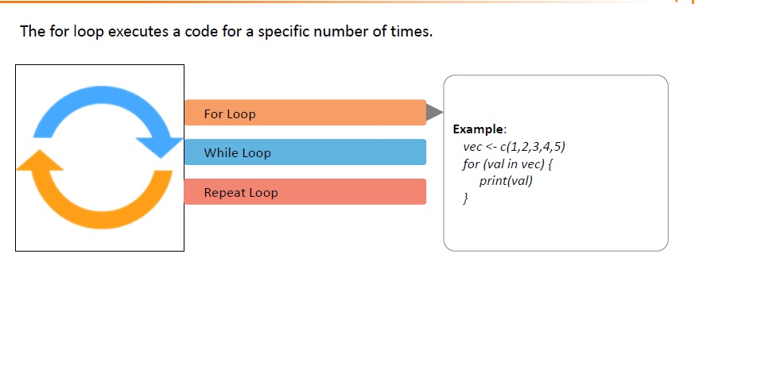

Slide 13
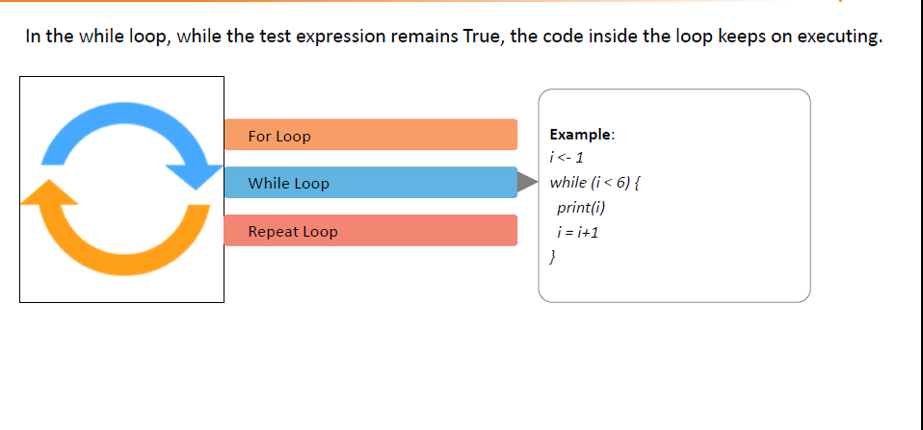

Slide 14
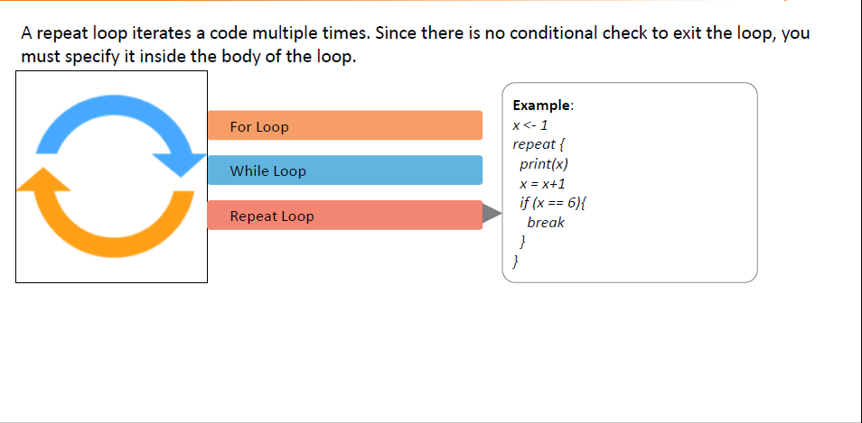

Slide 15
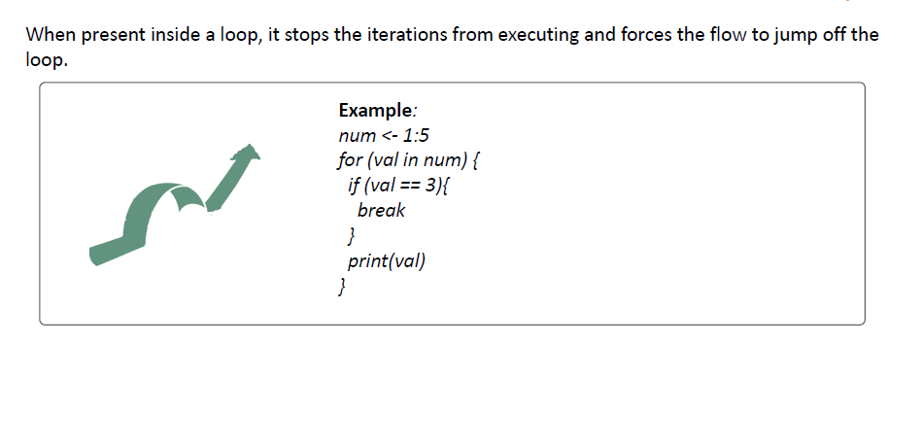

Slide 16
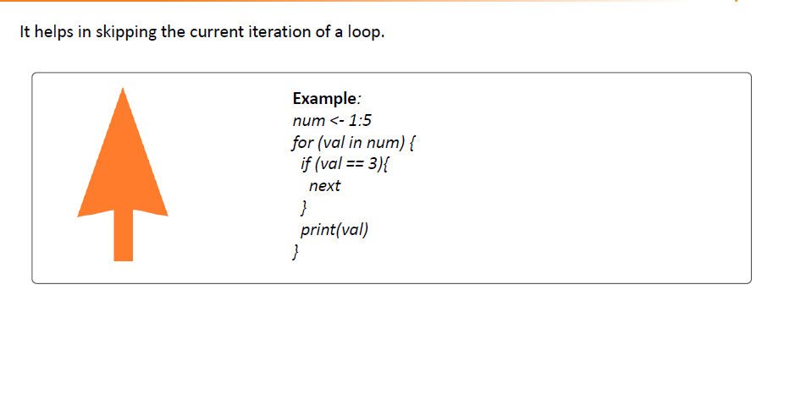

Slide 17

Scan()

Slide 18
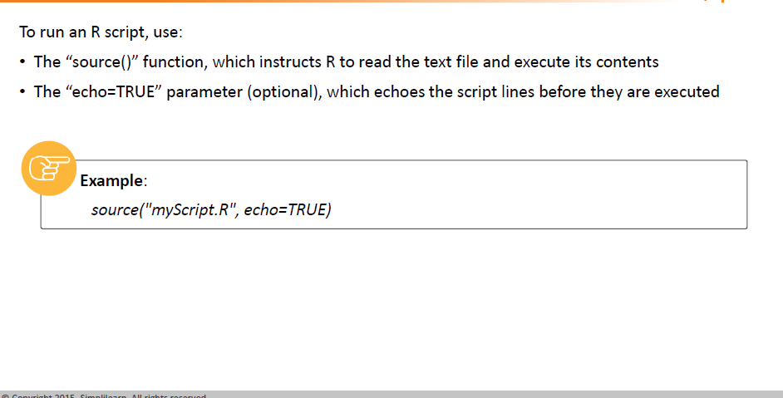
Source()

Slide 19
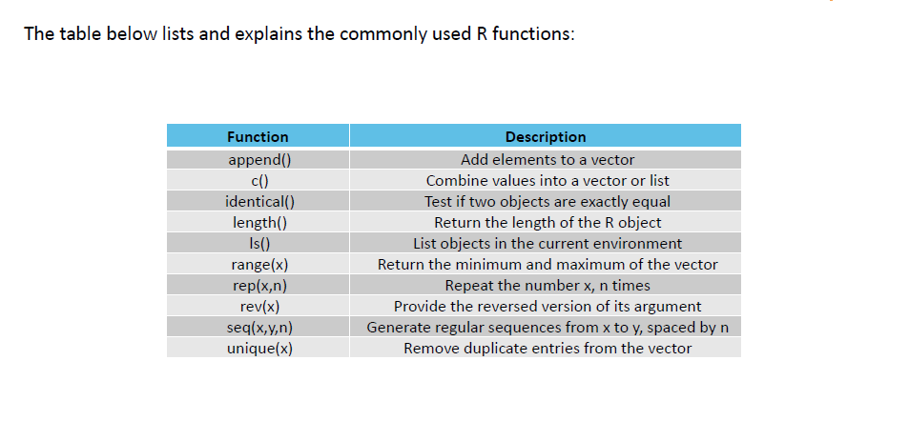

Slide 20
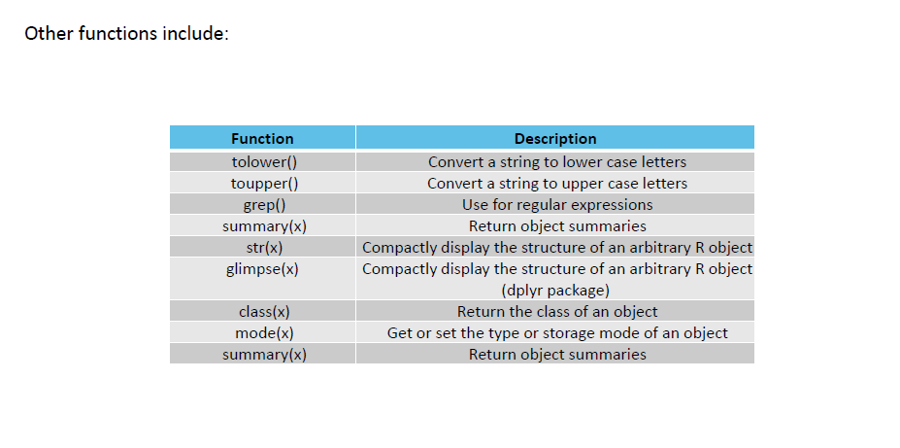

Slide 21
SLR
Linear regression is used to predict the value of an outcome variable Y based on one or more input predictor variables X. The aim is to establish a linear relationship (a mathematical formula) between the predictor variable(s) and the response variable, so that, we can use this formula to estimate the value of the response Y, when only the predictors (Xs) values are known.

Slide 22
Introduction
The aim of linear regression is to model a continuous variable Y as a mathematical function of one or more X variable(s), so that we can use this regression model to predict the Y when only the X is known. This mathematical equation can be generalized as follows:
Y = β₁ + β₂X + ϵ
where, β₁ is the intercept and β₂ is the slope. Collectively, they are called regression coefficients. ϵ is the error term, the part of Y the regression model is unable to explain.

Slide 23
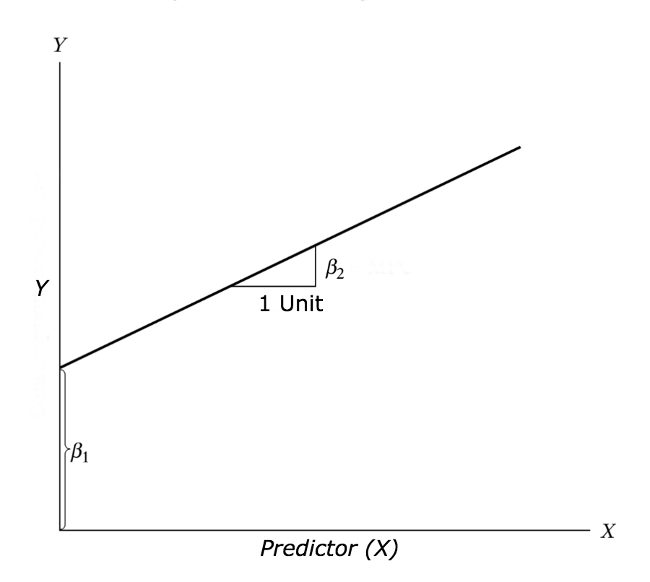

Slide 24
Example Problem
For this analysis, we will use the cars dataset that comes with R by default. cars is a standard built-in dataset, that makes it convenient to demonstrate linear regression in a simple and easy to understand fashion. You can access this dataset simply by typing in cars in your R console. You will find that it consists of 50 observations(rows) and 2 variables (columns) – dist and speed. Lets print out the first six observations here..
Before we begin building the regression model, it is a good practice to analyze and understand the variables. The graphical analysis and correlation study below will help with this.

Slide 25
head(cars) # display the first 6 observations #
> speed dist
#> 1 4 2
#> 2 4 10
#> 3 7 4
#> 4 7 22
#> 5 8 16
#> 6 9 10

Slide 26
Scatter Plot
Scatter plots can help visualize any linear relationships between the dependent (response) variable and independent (predictor) variables. Ideally, if you are having multiple predictor variables, a scatter plot is drawn for each one of them against the response, along with the line of best as seen below.
scatter.smooth(x=cars$speed, y=cars$dist, main="Dist ~ Speed") # scatterplot

Slide 27
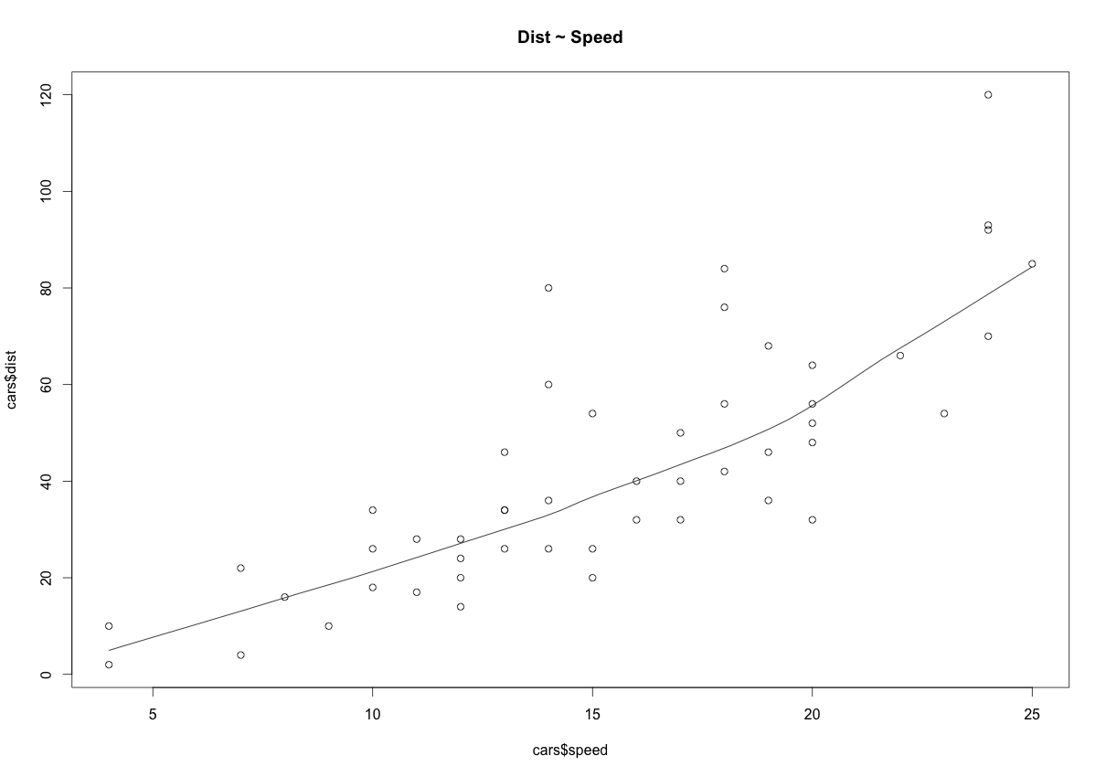

Slide 28
BoxPlot – Check for outliers
Generally, any datapoint that lies outside the 1.5 * interquartile-range (1.5 * IQR) is considered an outlier, where, IQR is calculated as the distance between the 25th percentile and 75th percentile values for that variable.
par(mfrow=c(1, 2)) # divide graph area in 2 columns boxplot(cars$speed, main="Speed", sub=paste("Outlier rows: ", boxplot.stats(cars$speed)$out)) # box plot for 'speed'
boxplot(cars$dist, main="Distance", sub=paste("Outlier rows: ", boxplot.stats(cars$dist)$out)) # box plot for 'distance'

Slide 29
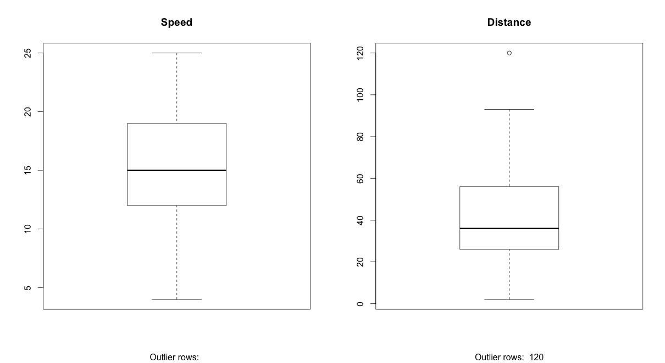

Slide 30
Correlation
Correlation is a statistical measure that suggests the level of linear dependence between two variables, that occur in pair – just like what we have here in speed and dist. Correlation can take values between -1 to +1. If we observe for every instance where speed increases, the distance also increases along with it, then there is a high positive correlation between them and therefore the correlation between them will be closer to 1. The opposite is true for an inverse relationship, in which case, the correlation between the variables will be close to -1.
A value closer to 0 suggests a weak relationship between the variables. A low correlation (-0.2 < x < 0.2) probably suggests that much of variation of the response variable (Y) is unexplained by the predictor (X), in which case, we should probably look for better explanatory variables.
cor(cars$speed, cars$dist) # calculate correlation between speed and distance #> [1] 0.8068949

Slide 31
Build Linear Model
Now that we have seen the linear relationship pictorially in the scatter plot and by computing the correlation, lets see the syntax for building the linear model. The function used for building linear models is lm(). The lm() function takes in two main arguments, namely: 1. Formula 2. Data. The data is typically a data.frame and the formula is a object of class formula. But the most common convention is to write out the formula directly in place of the argument as written below.
linearMod <- lm(dist ~ speed, data=cars) # build linear regression model on full data print(linearMod) #> Call: #> lm(formula = dist ~ speed, data = cars) #>
#> Coefficients:
#> (Intercept) speed #
> -17.579 3.932

Slide 32
For the above output, you can notice the ‘Coefficients’ part having two components: Intercept: -17.579, speed: 3.932 These are also called the beta coefficients. In other words, dist = Intercept + (β ∗ speed) => dist = −17.579 + 3.932∗speed

Slide 33
The p Value: Checking for statistical significance
The summary statistics above tells us a number of things. One of them is the model p-Value (bottom last line) and the p-Value of individual predictor variables (extreme right column under ‘Coefficients’). The p-Values are very important because, We can consider a linear model to be statistically significant only when both these p-Values are less that the pre-determined statistical significance level, which is ideally 0.05. This is visually interpreted by the significance stars at the end of the row. The more the stars beside the variable’s p-Value, the more significant the variable.
Null and alternate hypothesis
When there is a p-value, there is a hull and alternative hypothesis associated with it. In Linear Regression, the Null Hypothesis is that the coefficients associated with the variables is equal to zero. The alternate hypothesis is that the coefficients are not equal to zero (i.e. there exists a relationship between the independent variable in question and the dependent variable).

Slide 34
t-value
We can interpret the t-value something like this. A larger t-value indicates that it is less likely that the coefficient is not equal to zero purely by chance. So, higher the t-value, the better.
Pr(>|t|) or p-value is the probability that you get a t-value as high or higher than the observed value when the Null Hypothesis (the β coefficient is equal to zero or that there is no relationship) is true. So if the Pr(>|t|) is low, the coefficients are significant (significantly different from zero). If the Pr(>|t|) is high, the coefficients are not significant.
What this means to us? when p Value is less than significance level (< 0.05), we can safely reject the null hypothesis that the co-efficient β of the predictor is zero. In our case, linearMod, both these p-Values are well below the 0.05 threshold, so we can conclude our model is indeed statistically significant.

Slide 35
How to calculate the t Statistic and p-Values?
When the model co-efficients and standard error are known, the formula for calculating t Statistic and p-Value is as follows: t−Statistic=β−coefficient/Std.Error

Slide 36
R-Squared and Adj R-Squared
The actual information in a data is the total variation it contains, remember?. What R-Squared tells us is the proportion of variation in the dependent (response) variable that has been explained by this model.
R²=1-SSE/SST
where, SSE is the sum of squared errors given by SSE=∑(yi−yi^)²
SST=∑(yi−yi¯) is the sum of squared total.
Here, yi^is the fitted value for observation i and y¯ is the mean of Y.
We don’t necessarily discard a model based on a low R-Squared value. Its a better practice to look at the AIC and prediction accuracy on validation sample when deciding on the efficacy of a model.

Slide 37
Now thats about R-Squared. What about adjusted R-Squared? As you add more X variables to your model, the R-Squared value of the new bigger model will always be greater than that of the smaller subset. This is because, since all the variables in the original model is also present, their contribution to explain the dependent variable will be present in the super-set as well, therefore, whatever new variable we add can only add (if not significantly) to the variation that was already explained. It is here, the adjusted R-Squared value comes to help. Adj R-Squared penalizes total value for the number of terms (read predictors) in your model. Therefore when comparing nested models, it is a good practice to look at adj-R-squared value over R-squared.

Slide 38
R²adj=1−MSE/MST where, MSE is the mean squared error given by MSE=SSE/(n−q) and
MST=SST/(n−1)
is the mean squared total, where n is the number of observations and q is the number of coefficients in the model.

Slide 39
Standard Error and F-Statistic
Both standard errors and F-statistic are measures of goodness of fit.
Std.Error=sqrt(MSE)=√(SSE/n−q)
F−statistic=MSR/MSE
where, n is the number of observations, q is the number of coefficients and MSR is the mean square regression, calculated as,
MSR=∑(yi−y¯^)/q−1=(SST−SSE)/(q−1)

Slide 40
Problem Statement
Last year, five randomly selected students took a math aptitude test before they began their statistics course. The Statistics Department has three questions.
What linear regression equation best predicts statistics performance, based on math aptitude scores?
If a student made an 80 on the aptitude test, what grade would we expect her to make in statistics?
How well does the regression equation fit the data?
How to Find the Regression Equation
In the table below, the x_{i} column shows scores on the aptitude test. Similarly, the y_{i} column shows statistics grades. The last two rows show sums and mean scores that we will use to conduct the regression analysis.

Slide 41
Student | x_{i} | y_{i}
1 | 95 | 85
2 | 85 | 95
3 | 80 | 70
4 | 70 | 65
5 | 60 | 70
sum | 390 | 385
mean | 78 | 77

Slide 42
Student | x_{i} | y_{i} | (x_{i} - x) | (y_{i} - y)
1 | 95 | 85 | 17 | 8
2 | 85 | 95 | 7 | 18
3 | 80 | 70 | 2 | -7
4 | 70 | 65 | -8 | -12
5 | 60 | 70 | -18 | -7
sum | 390 | 385
mean | 78 | 77

Slide 43
Student | x_{i} | y_{i} | (x_{i} - x) | (y_{i} - y) | (x_{i} - x)² | (y_{i} - y)²
1 | 95 | 85 | 17 | 8 | 289 | 64
2 | 85 | 95 | 7 | 18 | 49 | 324
3 | 80 | 70 | 2 | -7 | 4 | 49
4 | 70 | 65 | -8 | -12 | 64 | 144
5 | 60 | 70 | -18 | -7 | 324 | 49
sum | 390 | 385 |  |  | 730 | 630
mean | 78 | 77

Slide 44
Student | x_{i} | y_{i} | (x_{i} - x) | (y_{i} - y) | (x_{i} - x)² | (y_{i} - y)² | (x_{i} - x)(y_{i} - y)
1 | 95 | 85 | 17 | 8 | 289 | 64 | 136
2 | 85 | 95 | 7 | 18 | 49 | 324 | 126
3 | 80 | 70 | 2 | -7 | 4 | 49 | -14
4 | 70 | 65 | -8 | -12 | 64 | 144 | 96
5 | 60 | 70 | -18 | -7 | 324 | 49 | 126
sum | 390 | 385 |  |  | 730 | 630 | 470
mean | 78 | 77

Slide 45
The regression equation is a linear equation of the form: ŷ = b₀ + b₁x . To conduct a regression analysis, we need to solve for b₀ and b₁. Computations are shown below.
b₁ = Σ [ (x_{i} - x)(y_{i} - y) ] / Σ [ (x_{i} - x)²] b₁ = 470/730 = 0.644
b₀ = y - b₁ * x b₀ = 77 - (0.644)(78) = 26.768
Therefore, the regression equation is: ŷ = 26.768 + 0.644x .

Slide 46
Once you have the regression equation, using it is a snap. Choose a value for the independent variable (x), perform the computation, and you have an estimated value (ŷ) for the dependent variable.
In our example, the independent variable is the student's score on the aptitude test. The dependent variable is the student's statistics grade. If a student made an 80 on the aptitude test, the estimated statistics grade would be:
ŷ = 26.768 + 0.644x = 26.768 + 0.644 * 80 = 26.768 + 51.52 = 78.288

Slide 47
How to Find the Coefficient of Determination
Whenever you use a regression equation, you should ask how well the equation fits the data. One way to assess fit is to check the coefficient of determination, which can be computed from the following formula.
R² = { ( 1 / N ) * Σ [ (x_{i} - x) * (y_{i} - y) ] / (σ_{x} * σ_{y} ) }²
where N is the number of observations used to fit the model, Σ is the summation symbol, x_{i} is the x value for observation i, x is the mean x value, y_{i} is the y value for observation i, y is the mean y value, σ_{x} is the standard deviation of x, and σ_{y} is the standard deviation of y. Computations for the sample problem of this lesson are shown below.
σ_{x} = sqrt [ Σ ( x_{i} - x )² / N ] σ_{x} = sqrt( 730/5 ) = sqrt(146) = 12.083
σ_{y} = sqrt [ Σ ( y_{i} - y )² / N ] σ_{y} = sqrt( 630/5 ) = sqrt(126) = 11.225
R² = { ( 1 / N ) * Σ [ (x_{i} - x) * (y_{i} - y) ] / (σ_{x} * σ_{y} ) }² R² = [ ( 1/5 ) * 470 / ( 12.083 * 11.225 ) ]² = ( 94 / 135.632 )² = ( 0.693 )² = 0.48

Slide 48
A coefficient of determination equal to 0.48 indicates that about 48% of the variation in statistics grades (the dependent variable) can be explained by the relationship to math aptitude scores (theindependent variable). This would be considered a good fit to the data, in the sense that it would substantially improve an educator's ability to predict student performance in statistics class.

Slide 49
Residuals
The difference between the observed value of the dependent variable (y) and the predicted value (ŷ) is called the residual (e). Each data point has one residual.
Residual = Observed value - Predicted value e = y - ŷ
Both the sum and the mean of the residuals are equal to zero. That is, Σ e = 0 and e = 0.

Slide 50
Residual Plots
A residual plot is a graph that shows the residuals on the vertical axis and the independent variable on the horizontal axis. If the points in a residual plot are randomly dispersed around the horizontal axis, a linear regression model is appropriate for the data; otherwise, a non-linear model is more appropriate.
Below, the table shows inputs and outputs from a simple linear regression analysis.

Slide 51
x | 60 | 70 | 80 | 85 | 95
y | 70 | 65 | 70 | 95 | 85
ŷ | 65.411 | 71.849 | 78.288 | 81.507 | 87.945
e | 4.589 | -6.849 | -8.288 | 13.493 | -2.945

Slide 52
And the chart below displays the residual (e) and independent variable (X) as a residual plot.
The residual plot shows a fairly random pattern - the first residual is positive, the next two are negative, the fourth is positive, and the last residual is negative. This random pattern indicates that a linear model provides a decent fit to the data.

Slide 53
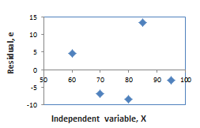

Slide 54
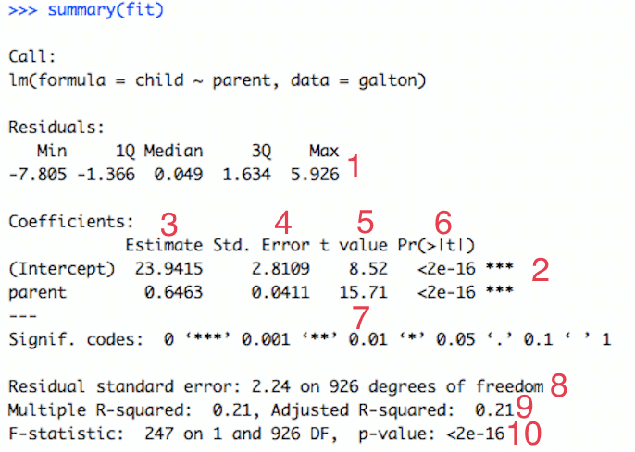

Slide 55
1 Residuals
The residuals are the difference between the actual values of the variable you're predicting and predicted values from your regression--y - ŷ. For most regressions you want your residuals to look like a normal distribution when plotted. If our residuals are normally distributed, this indicates the mean of the difference between our predictions and the actual values is close to 0 (good) and that when we miss, we're missing both short and long of the actual value, and the likelihood of a miss being far from the actual value gets smaller as the distance from the actual value gets larger. 2 Significance Stars
The stars are shorthand for significance levels, with the number of asterisks displayed according to the p-value computed. *** for high significance and * for low significance. In this case, *** indicates that it's unlikely that no relationship exists b/w heights of parents and heights of their children.
3 Estimated Coeffecient
The estimated coefficient is the value of slope calculated by the regression. It might seem a little confusing that the Intercept also has a value, but just think of it as a slope that is always multiplied by 1. This number will obviously vary based on the magnitude of the variable you're inputting into the regression, but it's always good to spot check this number to make sure it seems reasonable.
4 Standard Error of the Coefficient Estimate
Measure of the variability in the estimate for the coefficient. Lower means better but this number is relative to the value of the coefficient. As a rule of thumb, you'd like this value to be at least an order of magnitude less than the coefficient estimate.

Slide 56
In our example, the std error or the parent variable is 0.04 which is 16x less than the estimate of the coefficient (or 1.6 orders of magnitude greater).
5 t-value of the Coefficient Estimate
Score that measures whether or not the coefficient for this variable is meaningful for the model. You probably won't use this value itself, but know that it is used to calculate the p-value and the significance levels.
6 Variable p-value
Probability the variable is NOT relevant. You want this number to be as small as possible. If the number is really small, R will display it in scientific notation. In or example 2e-16 means that the odds that parent is meaningless is about ¹⁄₅₀₀₀₀₀₀₀₀₀₀₀₀₀₀₀
7 Significance Legend
The more punctuation there is next to your variables, the better. Blank=bad, Dots=pretty good, Stars=good, More Stars=very good
8 Residual Std Error / Degrees of Freedom
The Residual Std Error is just the standard deviation of your residuals. You'd like this number to be proportional to the quantiles of the residuals in #1. For a normal distribution, the 1st and 3rd quantiles should be 1.5 +/- the std error. The Degrees of Freedom is the difference between the number of observations included in your training sample and the number of variables used in your model (intercept counts as a variable).

Slide 57
9 R-squared
Metric for evaluating the goodness of fit of your model. Higher is better with 1 being the best. Corresponds with the amount of variability in what you're predicting that is explained by the model. In this instance, ~21% of the cause for a child's height is due to the height their parent.
.10F-statistic & resulting p-value
Performs an F-test on the model. This takes the parameters of our model (in our case we only have 1) and compares it to a model that has fewer parameters. In theory the model with more parameters should fit better. If the model with more parameters (your model) doesn't perform better than the model with fewer parameters, the F-test will have a high p-value (probability NOT significant boost). If the model with more parameters is better than the model with fewer parameters, you will have a lower p-value. The DF, or degrees of freedom, pertains to how many variables are in the model. In our case there is one variable so there is one degree of freedom.

